Slide 1
CHAPTER 3
HUMAN REPRODUCTION

Slide 2
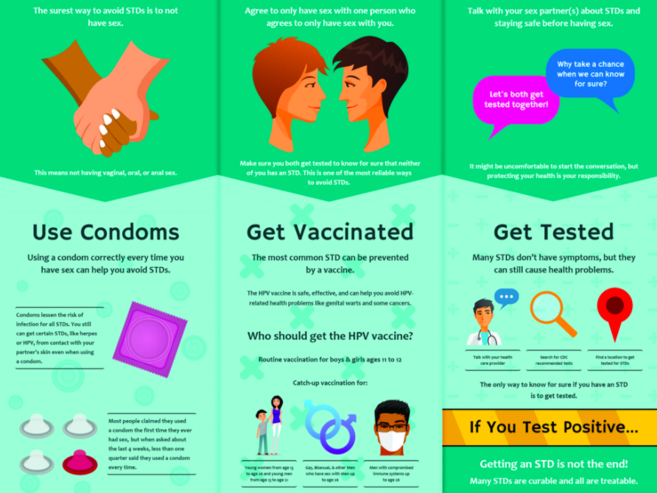
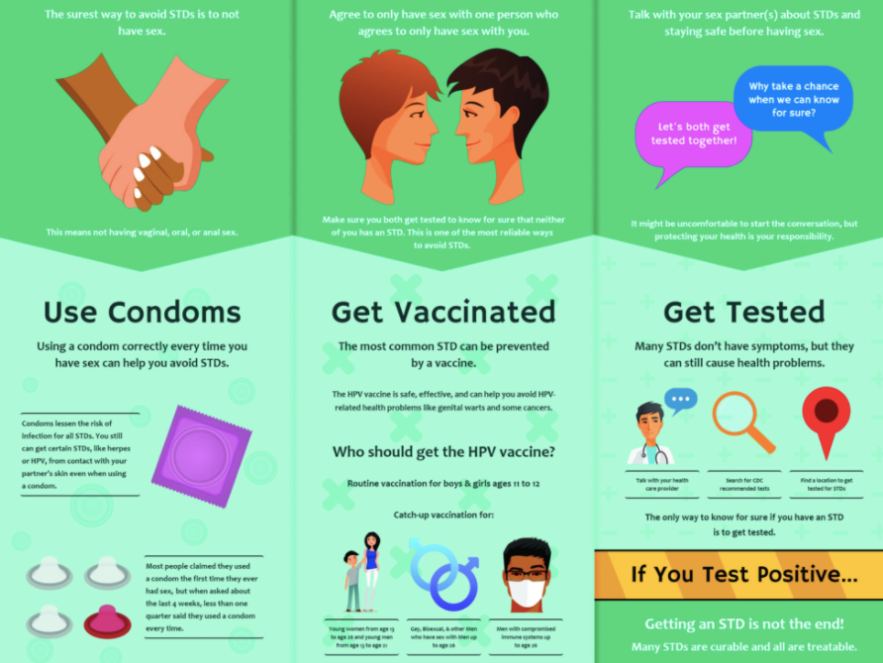
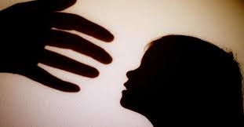

Why do we need to study human reproduction?
For awareness (sex education) in schools about various reproduction related aspects like;
various family planning techniques
preventive methods against sexually transmitted diseases.
consequences of uncontrolled population growth
Various social evils (sex abuses and sex related crimes, use of drugs, tobacco and alcohol, child marriage, etc.).

Slide 3

Stages of human life
Foetus in womb
18+ years onwards
Up to 3 years
Up to 13 years
Up to 18/19 years
Born
Babyhood
Childhood
Adolescence
Adulthood
Baby/Infant/Toddler
Child
Adolescent/Teenager
Adult
PUBERTY Starts
45-50 years of age
11-13 years in female (Menarche: Menstrual cycle starts)
13-14 years in male
Menopause: Stoppage of menstruation in female.
***Spermatogenesis continues throughout life

Slide 4
What are the remarkable differences between the reproductive events in the male and in the female?
Male | Female
Sperm formation continues even in old men | Formation of ovum ceases in women around the age of fifty years

Slide 5
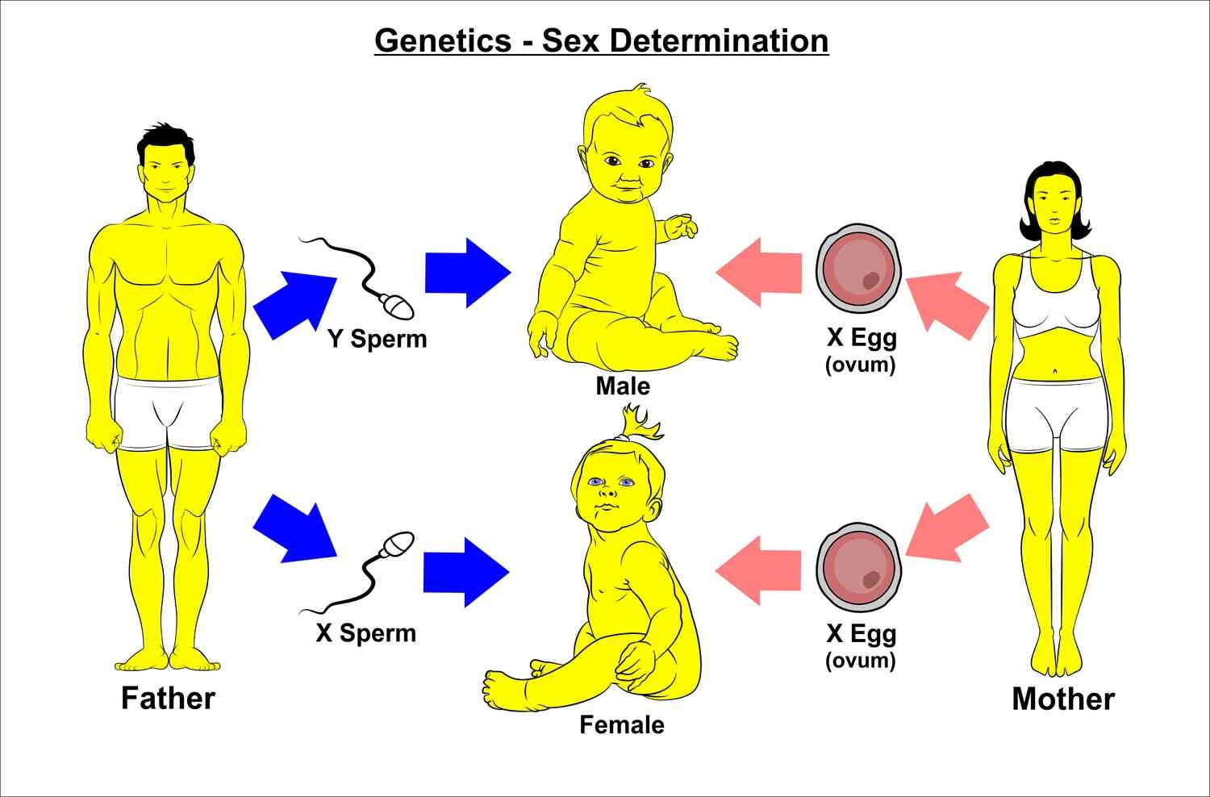
Determination of sex of a baby on the basis of sex chromosomal pattern
Humans are sexually reproducing and viviparous (producing living young, not eggs).
 | Female | Male
Sex Chromosomal Pattern
Sex chromosomes in gametes
Sex chromosomes in zygote
XX | XY
X or X | X or Y
XX | XY
Notes:
Humans are sexually reproducing and viviparous (producing living young, not eggs).
The reproductive events in humans
Puberty
Gametogenesis: Formation of gametes i.e., sperms in males and ovum in females
Insemination: Transfer of sperms into the female genital tract
Fertilisation: Fusion of male and female gametes leading to formation of zygote.
Formation and development of blastocyst and its attachment to the uterine wall (implantation).
Gestation: Embryonic development
Parturition: Delivery of the baby

Slide 6
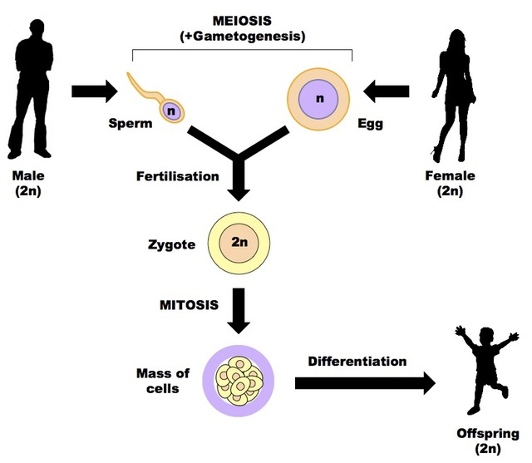
Overview of human reproduction (reproductive events)
Flow chart: Human reproduce sexually in the following manner
Gametogenesis since Puberty (Oogenesis/Spermatogenesis)
Gamete transfer (Insemination)
Fertilisation
Zygote formation
Implantation
Embryogenesis (Gestation)
Parturition (Delivery of baby)
Notes:
Humans are sexually reproducing and viviparous (producing living young, not eggs).
The reproductive events in humans
Puberty
Gametogenesis: Formation of gametes i.e., sperms in males and ovum in females
Insemination: Transfer of sperms into the female genital tract
Fertilisation: Fusion of male and female gametes leading to formation of zygote.
Formation and development of blastocyst and its attachment to the uterine wall (implantation).
Gestation: Embryonic development
Parturition: Delivery of the baby

Slide 7
THE MALE REPRODUCTIVE SYSTEM

Slide 8
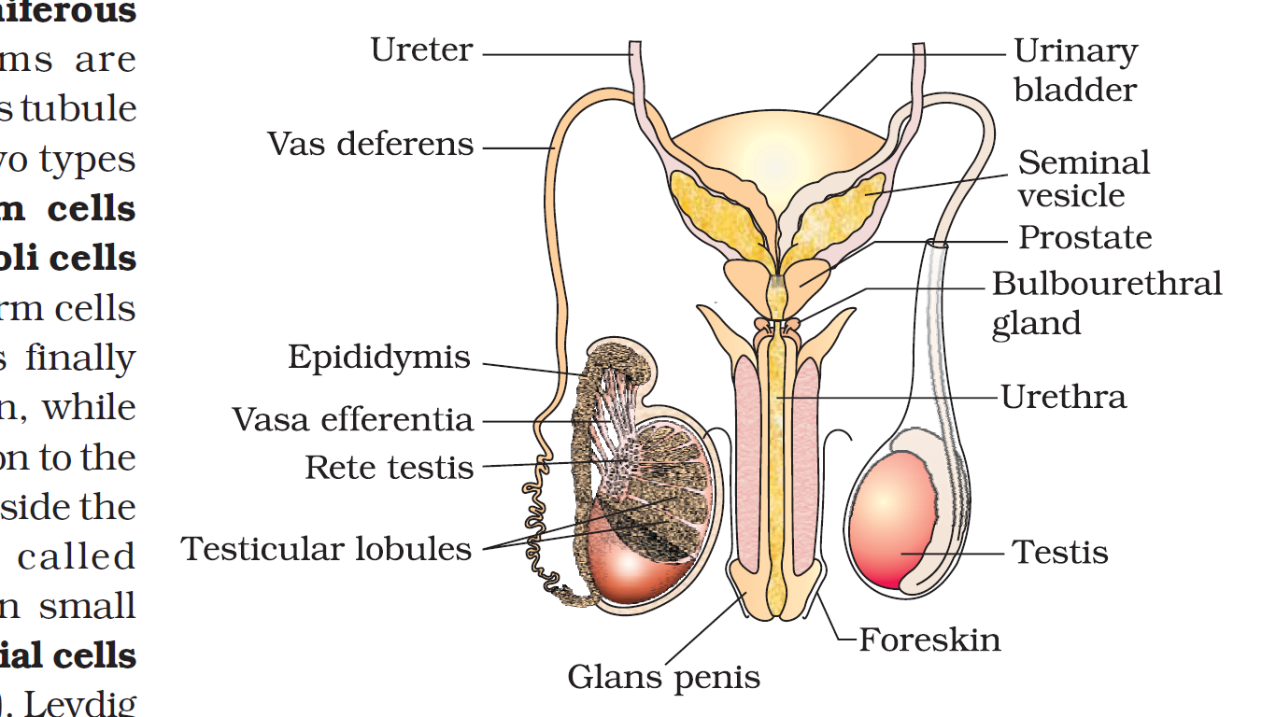
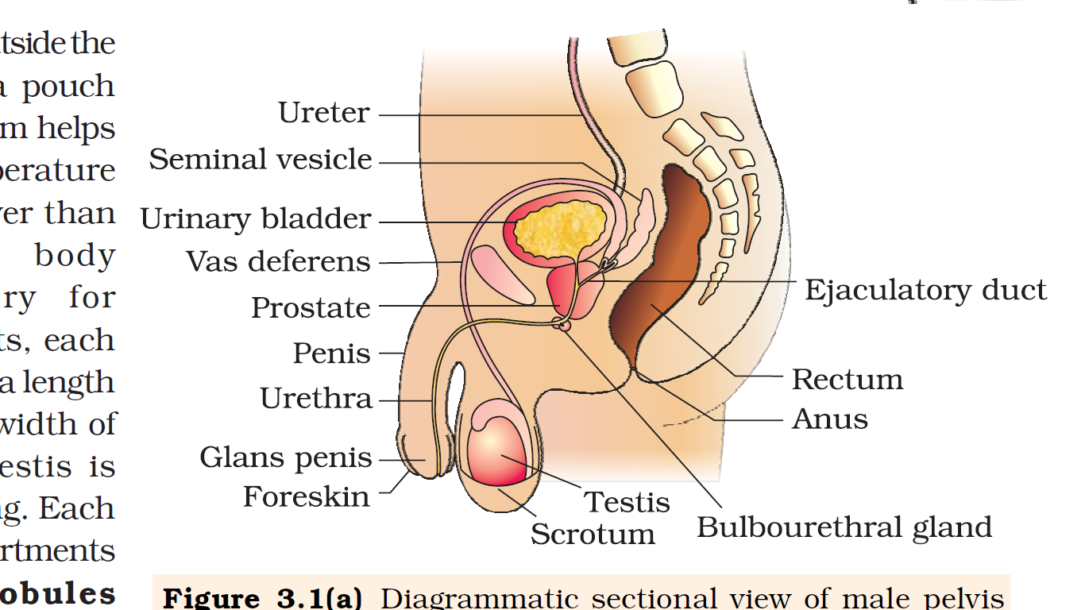
Figure Diagrammatic sectional view of male pelvis showing male reproductive system
Location of male reproductive system: Pelvic region
Parts of male reproductive system = A pair of testes + accessory duct + accessory glands + External genitalia
Accessory duct
= rete testis + vasa efferentia + epididymis + vas deferens
Accessory glands
= a pair of seminal vesicles + a prostate + pair of bulbourethral glands
External genitalia = Penis
Urethral meatus
Secretions of accessory glands constitute the seminal plasma which is rich in fructose, calcium and certain enzymes.
The secretions of bulbourethral glands also help in the lubrication of the penis.
Notes:
Humans are sexually reproducing and viviparous (producing living young, not eggs).
The reproductive events in humans
Puberty
Gametogenesis: Formation of gametes i.e., sperms in males and ovum in females
Insemination: Transfer of sperms into the female genital tract
Fertilisation: Fusion of male and female gametes leading to formation of zygote.
Formation and development of blastocyst and its attachment to the uterine wall (implantation).
Gestation: Embryonic development
Parturition: Delivery of the baby

Slide 9
Testes –the primary sex organ in male
Location of the testes: Outside the abdominal cavity within a pouch called scrotum.
The scrotum helps in maintaining the low temperature of the testes (2–2.5 ˚C lower than the normal internal body temperature) necessary for spermatogenesis.

Slide 10
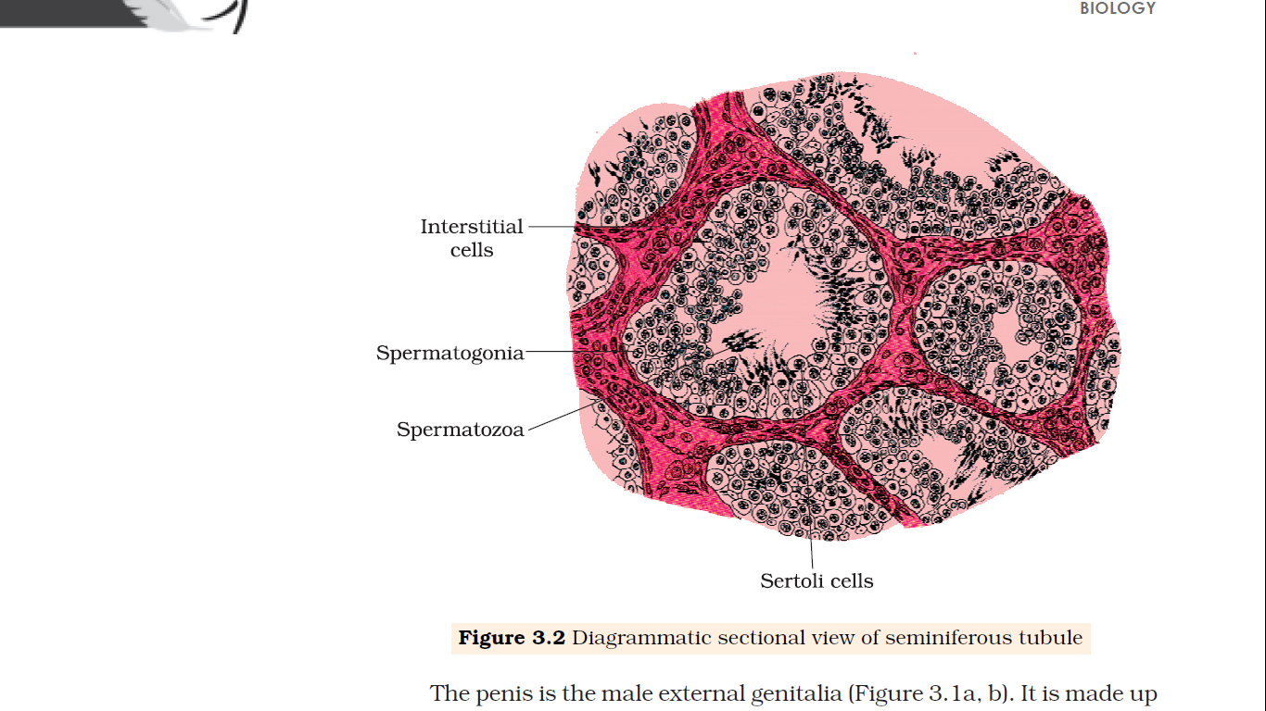
Structure of Testes
In adult males, each testis is
oval in shape
2 to 3 cm in width
4 to 5 cm in length
covered by tunica albuginea (a dense covering)
Each testis has about 250 testicular lobules(compartments)
Each testicular lobule contains one to three highly coiled seminiferous tubules
Sperms are produced in seminiferous tubules.
4 to 5 cm in length
Seminiferous tubules
2 to 3 cm in width
Testicular
lobule
Tunica albuginea
Figure: Diagrammatic sectional view of seminiferous tubule

Slide 11
Cells and structures in and around Seminiferous tubule
Cells lined inside each seminiferous tubule
Cells and structures in the interstitial spaces of seminiferous tubule
Male germ cells
(spermatogonia)
Sertoli cells
Leydig cells
(interstitial cells)
Immunologically competent cells
Small blood vessels
Spermatogenesis
Sperm
Provide nutritients to the germ cells
Synthesise and secrete
androgens (testicular hormones)
Notes:
Each seminiferous tubule is lined on its inside by two types of cells namely;
Male germ cells (spermatogonia)
Sertoli cells
Region outside seminiferous tubules are interstitial spaces, which are lined by;
Leydig cells
Immunologically competent cells
small blood vessels
The male germ cells undergo meiotic divisions finally leading to formation of sperm.
Sertoli cells provide nutrition to the germ cells.
Leydig/interstitial cells synthesise and secrete testicular hormones called androgens.

Slide 12
THE FEMALE REPRODUCTIVE SYSTEM

Slide 13
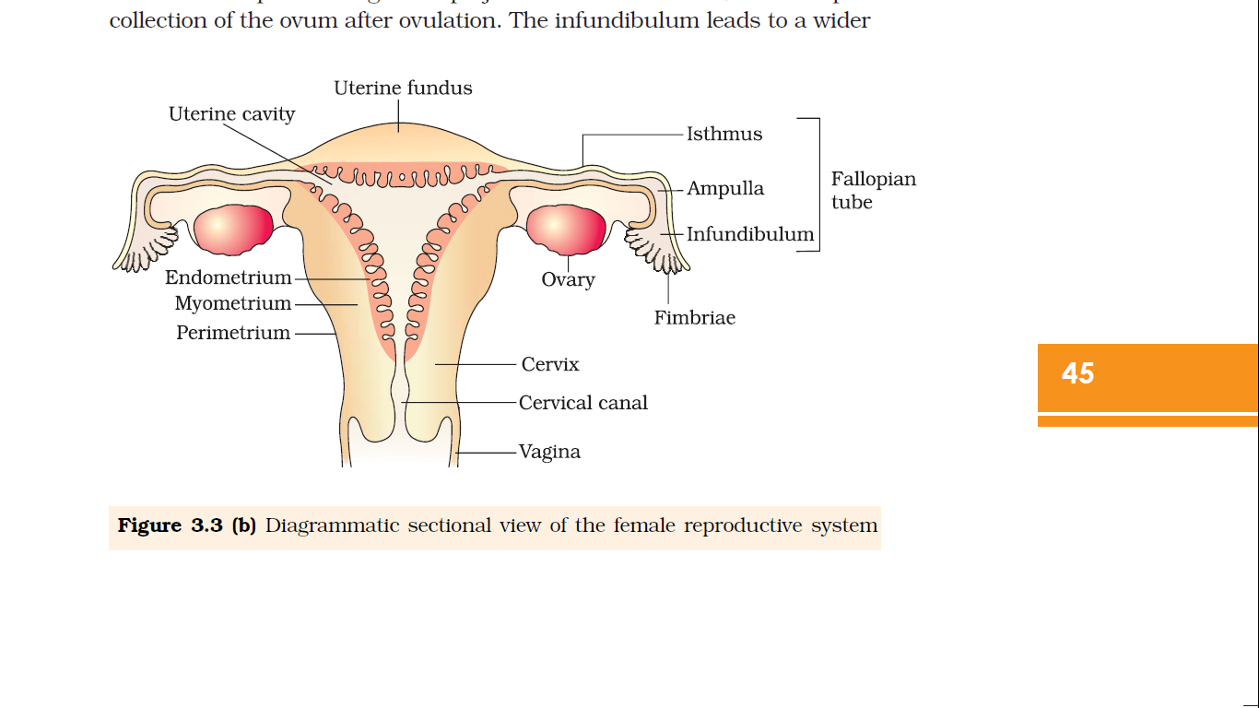
Figure Diagrammatic sectional view of the female reproductive system
Location: Pelvic region
Female reproductive system consists of
Primary sex organ (a pair of ovaries)
Accessory ducts
external genitalia (Vulva)
10-12 cm long
(narrow lumen)
(wider lumen)
The accessory ducts;
= oviducts (fallopian tubes) + Uterus
+ cervix + vagina
(funnel shaped)
External genitalia (vulva) include;
= mons pubis + labia majora + labia minora + hymen + clitoris
(finger-like projections)
Structural and functional parts in human female that support the reproduction (ovulation, fertilisation, pregnancy, birth and child care, etc);
reproductive system
mammary glands

Slide 14
Oviducts of human female Reproductive system
Each fallopian tube (10-12 cm long) extends from the periphery of each ovary to the uterus
Infundibulum: funnel shaped part closer to the ovary.
Fimbriae: finger-like projections at the edges of the infundibulum
Fimbriae helps in collection of the ovum after ovulation.
The infundibulum leads to a wider part of the oviduct called ampulla.
Isthmus: narrow lumen joining the uterus.

Slide 15
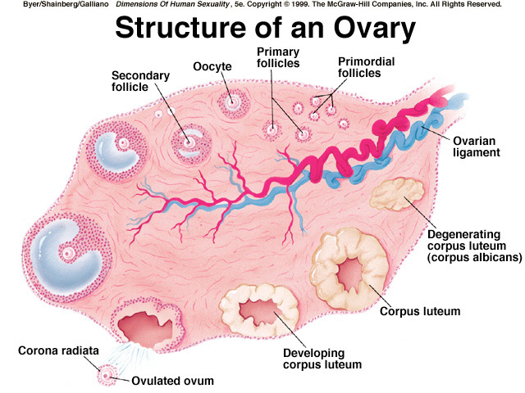
Ovaries
Structure of an ovary -primary female sex organs
Location: one on each side of the lower abdomen
Function: Production of ovum & ovarian hormones
Thin epithelium
Ovarian stroma
Medulla
2 to 4 cm in length
Cortex

Slide 16
Ovaries
Location: one on each side of the lower abdomen
Ovaries are the primary female sex organs
These produce the female gamete (ovum) and several steroid hormones (ovarian hormones).
Each ovary is about 2 to 4 cm in length
Each ovary is connected to the pelvic wall and uterus by ligaments.
Each ovary is covered by a thin epithelium which encloses the ovarian stroma.
The stroma is divided into two zones;
a peripheral cortex and
an inner medulla.

Slide 17
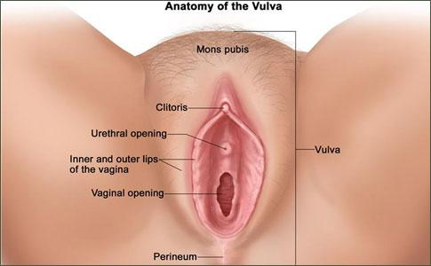
Figure: Anatomy of external genitalia (Vulva) of human female Reproductive system
(cushion of fatty tissue covered by skin and pubic hair)
Labia majora
(Outer, larger fleshy folds of tissue)
(tiny finger like structure )
Labia minora
(Inner, smaller fleshy folds of tissue)
Hymen
(membrane that partially covers the opening of the vagina)

Slide 18
External genitalia (Vulva) of human female Reproductive system
Mons pubis: cushion of fatty tissue covered by skin and pubic hair.
Labia majora: paired fleshy folds of tissue extending down from the mons pubis that surround the vaginal opening.
Labia minora: paired folds of tissue under the labia majora.
Hymen: membrane that partially covers the opening of the vagina.
Clitoris: a tiny finger-like structure which lies at the upper junction of the two labia minora above the urethral opening.

Slide 19
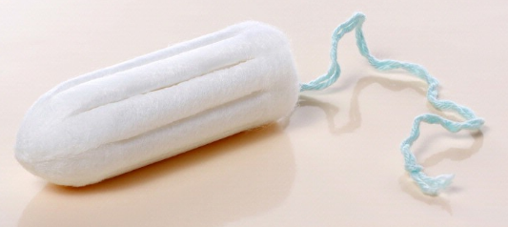
The hymen is often torn/ broken due to;
first coitus (intercourse)*
By different activities like
sudden fall
Jolt,
insertion of a vaginal tampon,
active participation in some sports like horseback riding, cycling, etc.
*Hymen may persists even after first coitus in some women

Slide 20
Mammary glands (breasts)
Mammary glands contain
Glandular tissue
Variable amount of fat
Divided into 15-20 mammary lobes
contain
Alveoli (clusters of cells)
Cells of alveoli secrete milk into lumens of alveoli
Alveoli open into mammary tubules
Mammary tubules of each lobe join to form a mammary duct
Several mammary ducts join to form a wider mammary ampulla
Mammary ampulla is connected to lactiferous duct
Lactiferous duct carries milk to nipple and is sucked out by baby

Slide 21
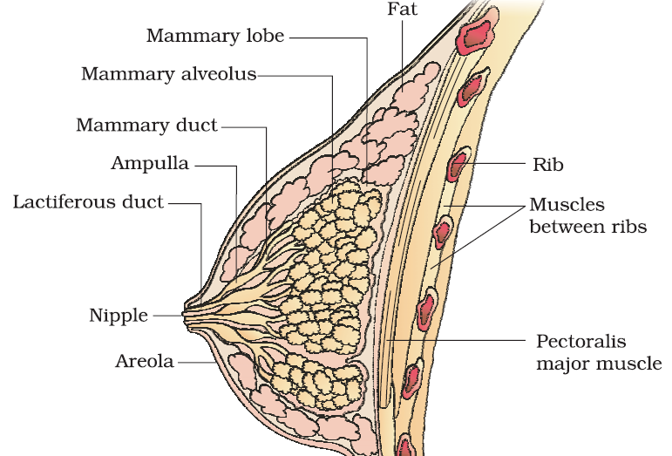
Figure A diagrammatic sectional view of Mammary gland (breasts)
Mammary tubules

Slide 22
Mammary gland
A functional mammary gland is characteristic of all female mammals.
The mammary glands are paired structures (breasts) that contain glandular tissue and variable amount of fat.
The glandular tissue of each breast is divided into 15-20 mammary lobes containing alveoli (clusters of cells).
The cells of alveoli secrete milk, which is stored in the cavities (lumens) of alveoli.
The alveoli open into mammary tubules.
The tubules of each lobe join to form a mammary duct.
Several mammary ducts join to form a wider mammary ampulla which is connected to lactiferous duct through which milk is sucked out.

Slide 23
Lactation (production of milk by mammary gland towards the end of pregnancy to feed newborn)
The mammary glands of the female undergo differentiation during pregnancy and starts producing milk towards the end of pregnancy by the process called lactation.
Lactation helps the mother in feeding the newborn.
Colostrum is the milk produced during the initial few days of lactation which contains several antibodies (mostly IgA) essential to develop resistance for the new-born babies.
Breast-feeding during the initial period of infant growth is recommended by doctors for bringing up a healthy baby.

Slide 24
Gametogenesis
Gameto
genesis

Slide 25
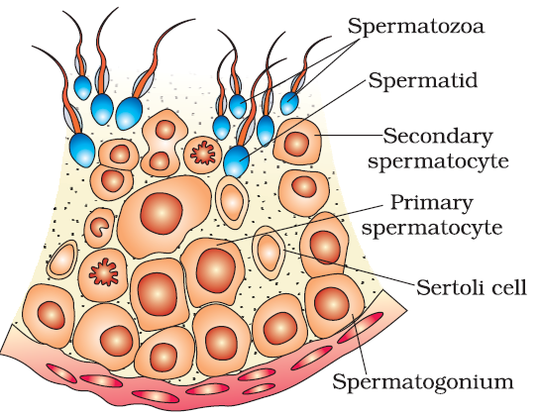
Figure Diagrammatic sectional view of a seminiferous tubule (enlarged)

Slide 26
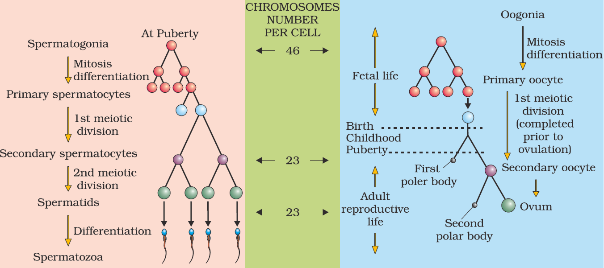
Gametogenesis
Spermatogenesis (gametogenesis in male)
Oogenesis (gametogenesis in female)
(Spermiogenesis)
Spermiation is a process of release of spermatozoa (sperm) from seminiferous tubules.
Semen = Seminal plasma + Sperm
*Seminal plasma = fructose + calcium + certain enzymes
Ovulation: Release of secondary oocyte (ovum) by rupturing of Graafian follicle

Slide 27
Spermatogenesis (Process of production of sperm) | Oogenesis (Process of formation of ovum)
Spermatogenesis takes place from puberty to old age A primary spermatocyte completes the first meiotic division leading to formation of two equal sized secondary spermatocytes There is no pause at prophase I stage in spermatogenesis. Spermatogonium produces four functional spermatozoa. | Oocytes are generated before birth in the foetus. A large number of these oocytes degenerate during the phase from birth to puberty. The oocytes continuously decrease in number, and it gets completely exhausted at menopause. Primary oocyte divides unequally by the first meiotic division resulting in the formation of a large haploid secondary oocyte and a tiny first polar body. Meiotic division of secondary oocyte gets temporarily arrested at Prophase-I stage. It is completed only when a sperm comes in contact with the zona pellucida layer of the ovum. An oogonium produces one functional ovum and three non-functional polar bodies.

Slide 28
Spermatogenesis
GnRH
Hypothalamus
GnRH: Gonadotropin releasing hormone
FSH: Follicle stimulating hormone
Posterior pituitary
LH: Luteinising hormone
Anterior pituitary
LH
Stimulate the process of spermatogenesis
FSH
Ledig cells
Seminiferous tubules
Sertoli cells
Testosterone
Stimulates secretion of some factors which help in the process of spermiogenesis

Slide 29
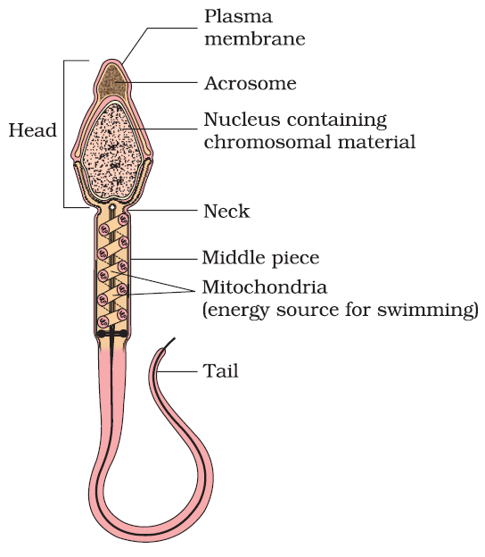
Figure: Structure of sperm

Slide 30
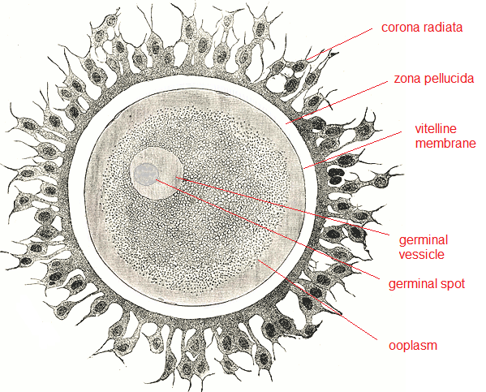
Structures of the egg cell

Slide 31
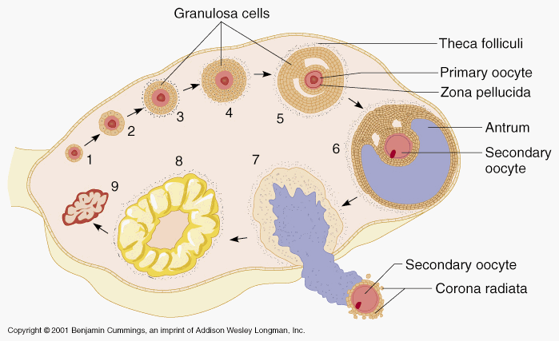

Slide 32
Structure of an ovary -primary female sex organs

Slide 33
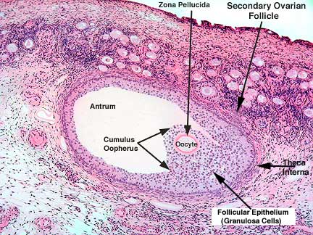
Theca externa

Slide 34
Spermatogenesis
The human male ejaculates about 200 to 300 million sperms during a coitus
For normal fertility, at least 60% sperms must have normal shape and size and for at least 40% sperm must show vigorous motility.
Sperms released from the seminiferous tubules, are transported by the accessory ducts.
Secretions of epididymis, vas deferens, seminal vesicle and prostate are essential for maturation and motility of sperms.
Semen = Seminal plasma + Sperm
Seminal plasma = fructose + calcium + certain enzymes
The functions of male sex accessory ducts and glands are maintained by the testicular hormones (androgens).
Spermatogenesis starts at puberty
During puperty there is significant increase in the secretion of gonadotropin releasing hormone (GnRH) -a hypothalamic hormone.
The increased levels of GnRH then acts at the anterior pituitary gland and stimulates secretion of two gonadotropins – luteinising hormone (LH) and follicle stimulating hormone (FSH).
LH acts at the Leydig cells and stimulates synthesis and secretion of androgens.
Androgens, in turn, stimulate the process of spermatogenesis.
FSH acts on the Sertoli cells and stimulates secretion of some factors which help in the process of spermiogenesis.

Slide 35
Oogenesis (The process of formation of a mature female gamete)
Millions of oogonia (gamete mother cells) are formed within each fetal ovary during the embryonic development; no more oogonia are formed and added after birth.
⇣ ^{Meiotic division}
Meiosis of Oogonia get temporarily arrested at prophase-I and are called primary oocytes
Each primary oocytes gets surrounded by primary follicle (a layer of granulosa cells).
⇣ ^{Degeneration} ^{of large number of} primary follicles (from birth to puberty); 60,000-80,000 primary follicles are left in each ovary during puberty
Primary follicles get surrounded by secondary follicles (more layers of granulosa cells)
The secondary follicles transforms into a tertiary follicles which are surrounded by an theca interna and a theca externa (and have an antrum -fluid filled cavity).
The primary oocyte within the tertiary follicle grows in size
After meiosis I of primary oocyte, a large haploid secondary oocyte and a tiny first polar body are formed
Entry of sperm into the cytoplasm of the ovum (through the zona pellucida and the plasma membrane) induces the completion of the metaphase II of the secondary oocyte.
The second meiosis results in the formation of a second polar body and a haploid ovum (ootid).
Later, haploid ootid will develop into ovum
The tertiary follicle further changes into the mature follicle or Graafian follicle.
The secondary oocyte forms a new membrane called zona pellucida surrounding it.
The Graafian follicle ruptures to release the secondary oocyte (ovum) from the ovary by the process called ovulation.
Notes:
Oogenesis is initiated during the embryonic development stage
Millions of gamete mother cells (oogonia) are formed within each fetal ovary; no more oogonia are formed and added after birth.
Oogonia start meiotic division and get temporarily arrested at prophase-I of the meiotic division and are called primary oocytes.
Each primary oocyte then gets surrounded by a layer of granulosa cells and then called the primary follicle.
A large number of these follicles degenerate during the phase from birth to puberty.
At puberty only 60,000-80,000 primary follicles are left in each ovary.
The primary follicles get surrounded by more layers of granulosa cells and a new theca and called secondary follicles.
The secondary follicle soon transforms into a tertiary follicle which is characterised by a fluid filled cavity called antrum.
The theca layer (tertiary follicle) is organised into
an inner theca interna and
an outer theca externa.
The primary oocyte within the tertiary follicle grows in size and completes its first meiotic division resulting in the formation of a large haploid secondary oocyte and a tiny first polar body.
Entry of sperm into the cytoplasm of the ovum through the zona pellucida and the plasma membrane induces the completion of the metaphase II of the secondary oocyte.
The second meiotic division results in the formation of a second polar body and a haploid ovum (ootid).
Later, haploid ootid will develop into ovum
The tertiary follicle further changes into the mature follicle or Graafian follicle.
The secondary oocyte forms a new membrane called zona pellucida surrounding it.
The Graafian follicle ruptures to release the secondary oocyte (ovum) from the ovary by the process called ovulation.
The tertiary follicle further changes into the mature follicle or Graafian follicle.
The secondary oocyte forms a new membrane called zona pellucida surrounding it.
The Graafian follicle ruptures to release the secondary oocyte (ovum) from the ovary by the process called ovulation.

Slide 36
Menstrual Cycle (Reproductive Cycle in female primates)
Menstrual cycle is the cycle of events starting from one menstruation till the next one in the female primates (e.g. monkeys, apes and human beings)
Cyclic menstruation is an indicator of normal reproductive phase.
In human females, menstruation is repeated at an average interval of about 28/29 days.
During pregnancy all events of the menstrual cycle stop and there is no menstruation.
Lack of menstruation may be caused due to stress, poor health, etc.
One ovum is released (ovulation) during the middle of each menstrual cycle.
Cyclic menstruation extends between menarche and menopause.
The first menstruation begins at puberty in human female and is called menarche.
In human females, menstrual cycles ceases around 50 years of age and is termed as menopause.
Phases of menstrual cycle are;
Menstrual phase
Follicular/proliferative phase
Ovulatory phase
Luteal/secretory phase

Slide 37
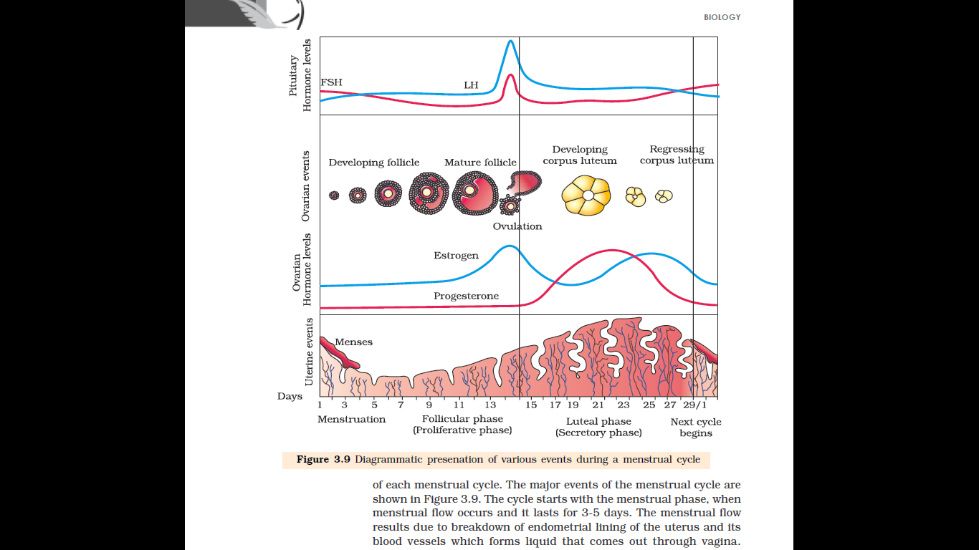
Figure Diagrammatic representation of various events during a menstrual cycle
LH surge
( around14th day)
(stimulate follicular development)
(secretion of estrogens and progesterone, helps ovulation)
(regulate menstrual cycle, develops secondary sexual characters)
(for maintenance of the endometrium)
Next menstrual cycle begins
Menstrual phase
Follicular phase
(proliferative phase)
Ovulatory
phase
Luteal phase
(secretory phase)

Slide 38
Phases of Menstrual Cycle
Phase | Menstrual phase | Follicular/proliferative phase | Ovulatory phase | Luteal phase/secretory phase
Menstrual phase
Occur menstrual flow* (results due to break down of endometrial lining of the uterus and its blood vessels which forms liquid that comes out through vagina)
Lasts for 3-5 days
*Menstruation only occurs if the released ovum is not fertilized
*Lack of menstruation may be
indicative of pregnancy
caused due to stress, poor health, etc.
Primary follicles become Graafian follicle.
Gradual increase in secretion of gonadotropins -LH and FSH (stimulate follicular development as well as secretion of estrogens by the growing follicles).
Endometrium (of uterus) regenerates through proliferation.
*Transformation of primary follicles to graafian follicle and proliferation of endometrium occurs simultaneously
Secretion of LH and FSH attain a peak level (about 14th day).
Rupture of Graafian follicle
Occur ovulation
*Rapid secretion of LH lead to LH surge (maximum level during the mid-cycle), which induces rupture of Graafian follicle and thereby releases ovum (ovulation).
Graafian follicle transform as the corpus luteum.
Secretion of large amounts of progesterone by corpus luteum.
Progesterone is essential for maintenance of the endometrium (for implantation of the fertilised ovum and other events of pregnancy).
In the absence of fertilisation, the corpus luteum degenerates and lead to menstruation, marking a new cycle.
Notes:
Menstrual phase
Occurrence of menstrual flow
lasts for 3-5 days
The menstrual flow results due to break down of endometrial lining of the uterus and its blood vessels which forms liquid that comes out through vagina.
Menstruation only occurs if the released ovum is not fertilised
Lack of menstruation may be
indicative of pregnancy
caused due to some other underlying causes like stress, poor health etc.
Follicular/proliferative phase
Primary follicles become Graafian follicle
secretion of gonadotropins (LH and FSH) increases gradually
Endometrium of uterus regenerates through proliferation.
Transformation of primary follicles to graafian follicle and proliferation of endometrium occurs simultaneously
The LH and FSH stimulate follicular development as well as secretion of estrogens by the growing follicles.
Both LH and FSH attain a peak level in the middle of cycle (about 14th day).
Rapid secretion of LH lead to LH surge (maximum level during the mid-cycle), which induces rupture of Graafian follicle and thereby releases ovum (ovulation).
Ovulatory phase
rupture of Graafian follicle
ovulation
Luteal phase/secretory phase
Graafian follicle transform as the corpus luteum.
The corpus luteum secretes large amounts of progesterone
Progesterone is essential for maintenance of the endometrium necessary for implantation of the fertilised ovum and other events of pregnancy.
In the absence of fertilisation, the corpus luteum degenerates causing disintegration of the endometrium leading to menstruation, marking a new cycle.

Slide 39
HUMAN EMBRYOLOGY

Slide 40
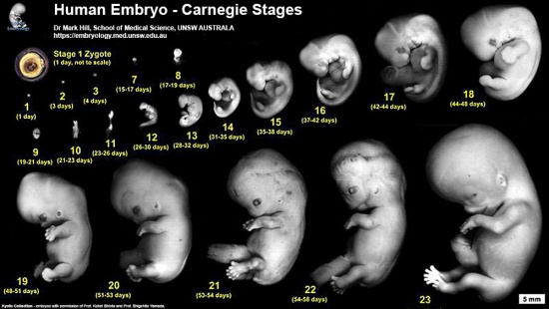

Slide 41

Human Embryonic and foetal development (Human Embryogenesis)
Cleavage
Zygote
Two celled stage
Four celled stage
Eight celled stage
Sixteen celled stage
←------------- Blastomeres ----------→
(cells produced by cleavage/cell division/mitosis of the zygote)
Morula ---→
(Latin, morus: mulberry)
Blastulation---→
--------------→ Gastrulation
---------→ Neurulation
---------→ Organogenesis--------→
Four weeks foetus
Ten weeks foetus
Sixteen weeks foetus
Twenty weeks foetus

Slide 42
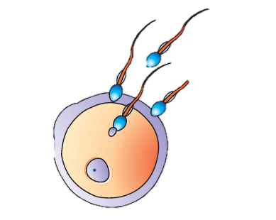
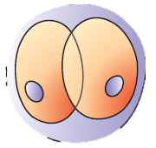
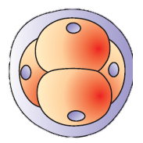
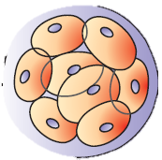
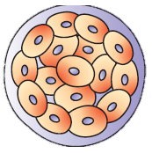
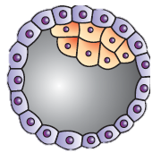
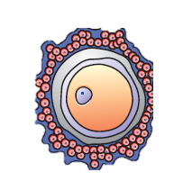
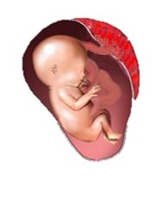
Embryo development
Pregnancy
(further development of embryo)
Implantation
Ampullary-isthmic junction
Blastocyst
Morula
(8-16 blastomeres)
Blastocyst
Trophoblast
Inner cell mass
Embryo
Blastocoel
Blastocyst
Ovulation
Blastomeres
Zygote
Fertilisation
During coitus
Insemination
200 to 300 million sperms

Slide 43

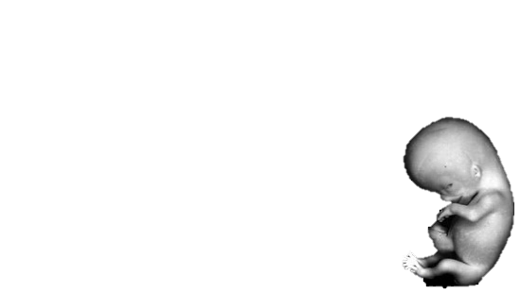
Pregnancy and embryonic development
Ninth months of gestation
Inner Cell Mass (ICM) [has stemcells]
First trimester
(First three months)
= 3
Second trimester
(Second three months)
= 3
Differentiate to form ectoderm, mesoderm and endoderm (*Gastrulation)
Third trimester
(Third three months)
= 3
Give rise to all tissues and organs
Total months of gestation = 9
After first Month: forms heart
After second month: develops limbs and digits.
12 weeks/3 months(First trimester): develop limbs, external genital organs
Fifth Month: Movements of foetus, Grow hairs on head.
Second trimester (24 weeks): Body covered with fine hairs, eye lids separates and eye lashes are formed.
Ninth month: foetus is fully developed and is ready for delivery
Parturition/Labour/Delivery (childbirth): process of delivery of the foetus
*formation of gut i.e formation of germ layers (Ectoderm,mesoderm & endoderm)

Slide 44
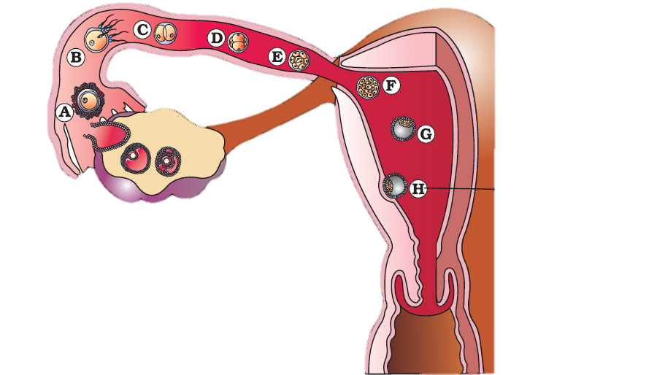
Transport of ovum, fertilisation and passage of growing embryo through fallopian tube
Blastocyst implantation

Slide 45
Fertilisation
During copulation (coitus) semen is released by the penis into the vagina (insemination).
The motile sperms swim rapidly, pass through the cervix, enter into the uterus and finally reach the ampulla or junction of the isthmus and ampulla (ampullary-isthmic junction) of the fallopian tube.
The ovum released by the ovary is also transported to the ampullary-isthmic junction where fertilization (process of fusion of a sperm with an ovum) takes place.
Fertilisation can only occur if the ovum and sperms are transported simultaneously to the ampullary-isthmic junction. Hence, not all copulations lead to fertilisation and pregnancy.
During fertilisation, a sperm comes in contact with the zona pellucida layer of the ovum and induces changes in the membrane that block the entry of additional sperms. Thus, it ensures that only one sperm can fertilise an ovum.
The secretions of the acrosome (hyaluronidase and acrosin) help the sperm enter into the cytoplasm of the ovum through the zona pellucida and the plasma membrane.
Entry of sperm into the cytoplasm of the ovum induces the completion of the meiotic II of the secondary oocyte halted at metaphase II.
The second meiotic division results in the formation of a second polar body and a haploid ovum (ootid).
Soon the haploid nucleus of the sperms and that of the ovum fuse together to form a diploid zygote.
Gender of the baby is determined by the chromosomal pattern in gametes to be fused.

Slide 46
Implantation
The repeated mitotic division (cleavage) starts as the zygote moves through the isthmus of the oviduct towards the uterus and forms 2, 4, 8, 16 daughter cells called blastomeres.
The embryo with 8 to 16 blastomeres is called a morula.
The morula continues to divide and transforms into blastocyst as it moves further into the uterus.
The blastomeres in the blastocyst are arranged into
Trophoblast (outer layer) and
inner cell mass (inner group of cells attached to trophoblast).
The trophoblast layer will be attached to the endometrium
The inner cell mass gets differentiated as the embryo.
After attachment, the uterine cells divide rapidly and covers the blastocyst.
Gradually, blastocyst becomes embedded in the endometrium of the uterus (implantation) and it leads to pregnancy
Trophoblast
Inner cell mass
Embryo
Blastocoel
Blastocyst

Slide 47
Pregnancy and embryonic development
Implantation
Attachment of blastocyst (at trophoblast) in the endometrium of uterus
Growth of chorionic villi
Finger like projections/vessels arose from chorion(fetal part of placenta) surrounded by uterine tissue and maternal blood vessel
Growth of placenta
Fetal development

Slide 48
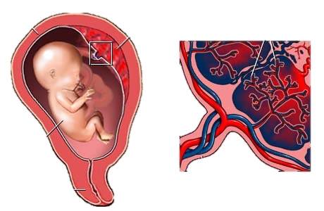
Placenta
Chorionic villi
Placenta is structural and functional unit between developing embryo and uterine tissue of maternal body.
Placenta is disc shaped structure formed by joining chorionic villi and uterine tissue.
Placenta is connected to embryo through umbilical cord.
Umbilical cord helps in transport of substance to and from embryo.
Umbilical cord
Uterus
Placenta
Foetus
Cervix

Slide 49

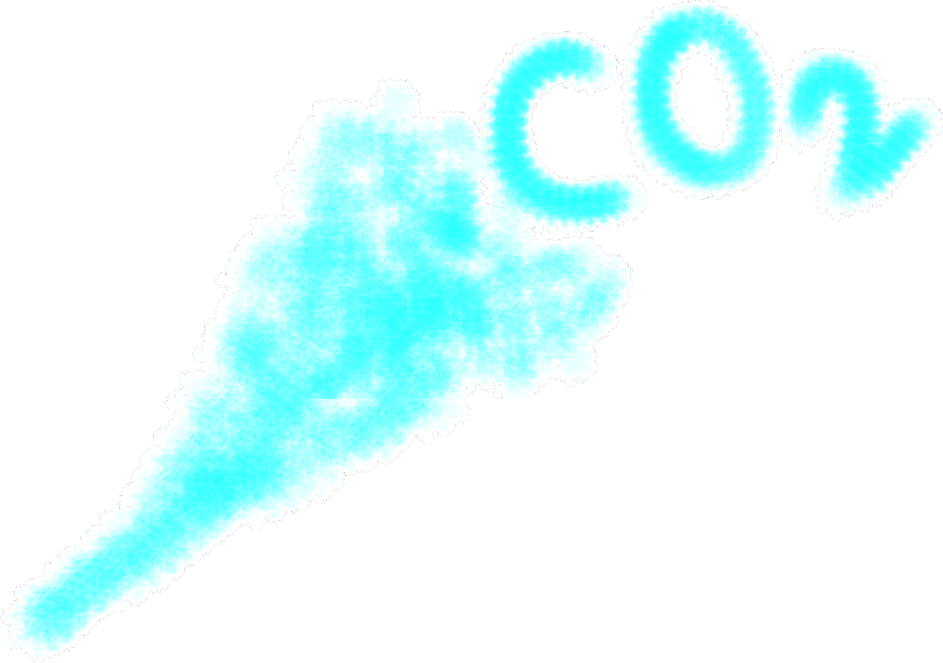
Role of placenta
+ Nutrients
Placenta facilitate supply of oxygen and nutrients to embryo
Removal of CO₂ and waste materials produced by embryo.
Placenta act as endocrine tissue and produces several hormones like;
Human Chorionic Gonadotropin (hCG)
Human Placental Lactogen(hPL)
Estrogens
Progesterone
Wastes +

Slide 50
Hormones involved in embryo development
Relaxin is secreted by ovary.
Relaxin softens pubic symphysis
Estrogen, progesterone, cortisol, prolactin, thyrosxine are essential for;
Supporting fetal growth,
Metabolic changes in the mother and
Maintenance of pregnancy.

Slide 51
(uterine contractions induced by a complex neuroendocrine mechanism for parturition
Foetal ejection reflex
Foetus and placenta
Signal
Maternal pituitary
Release
Oxytocin
Oxytocin acts on the uterine muscle
Causes strong uterine contractions
Stimulates further secretion of oxytocin
Result in stronger and stronger uterine contractions
Expulsion of the baby out of the uterus (Parturition)
Notes:
Foetal ejection reflex triggers release of oxytocin from the maternal pituitary.
Oxytocin acts on the uterine muscle and causes stronger uterine contractions, which in turn stimulates further secretion of oxytocin.
The stimulatory reflex between the uterine contraction and oxytocin secretion continues resulting in stronger and stronger contractions. This leads to expulsion of the baby out of the uterus through the birth canal (parturition).

Slide 52
End of the Chapter 3

Slide 53
Pregnancy and embryonic development

Slide 54
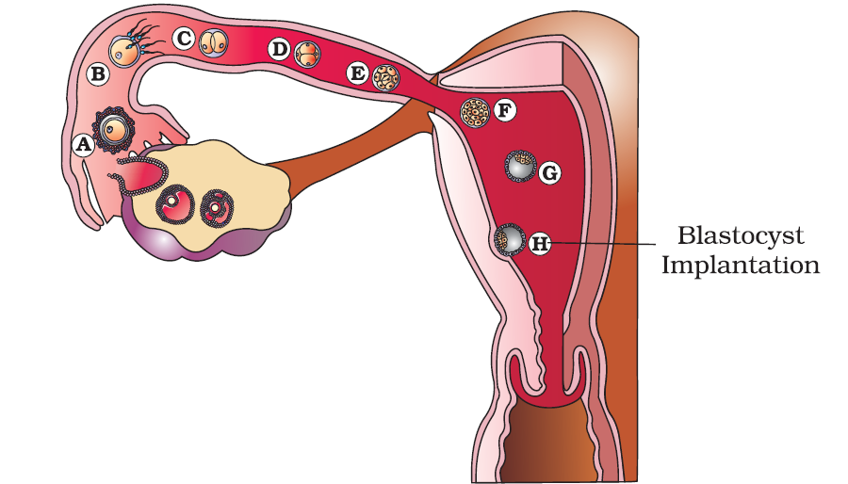
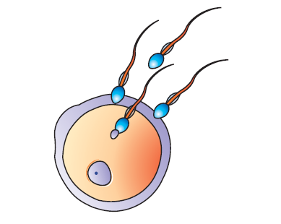
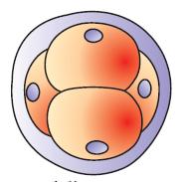
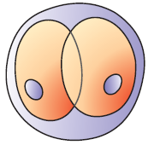
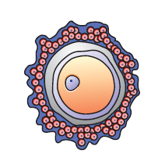
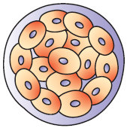
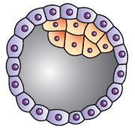
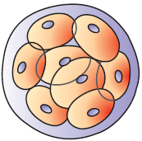
Transport of ovum, fertilisation and passage of growing embryo through fallopian tube
Morula
Blastocyst

Slide 55
PARTURITION
The average duration of human pregnancy is about 9 months which is called the gestation period.
Vigorous contraction of the uterus at the end of pregnancy causes expulsion/delivery of the foetus.
The process of delivery of the foetus (childbirth) is called parturition/Labour/Delivery.

Slide 56
Placenta
Name the structural and functional unit between developing embryo and maternal body.
Placenta is formed by joining __________ and ______________.
Enlist the major roles of placenta
Which cord connects placenta to embryo?
What is the major role of Umbilical cord?

Slide 57
PARTURITION AND LACTATION
What is the average duration of human pregnancy?
What is the biological term used for the period of human pregnancy?
The process of delivery of the foetus (childbirth) is called _____________
Where do the signals for parturition originate?
What is foetal ejection reflex?

Slide 58
Exercises
Humans are _____________ (asexually/sexually) reproducing and __________ (oviparous/viviparous i.e. producing living young, not eggs).
What are the reproductive events in humans?
When do spermatogenesis starts in human male? Why?

Slide 59
Exercises
Humans are _____________ (asexually/sexually) reproducing and __________ (oviparous/viviparous i.e. producing living young, not eggs).
What are the reproductive events in humans?
When do spermatogenesis starts in human male? Why?

Slide 60
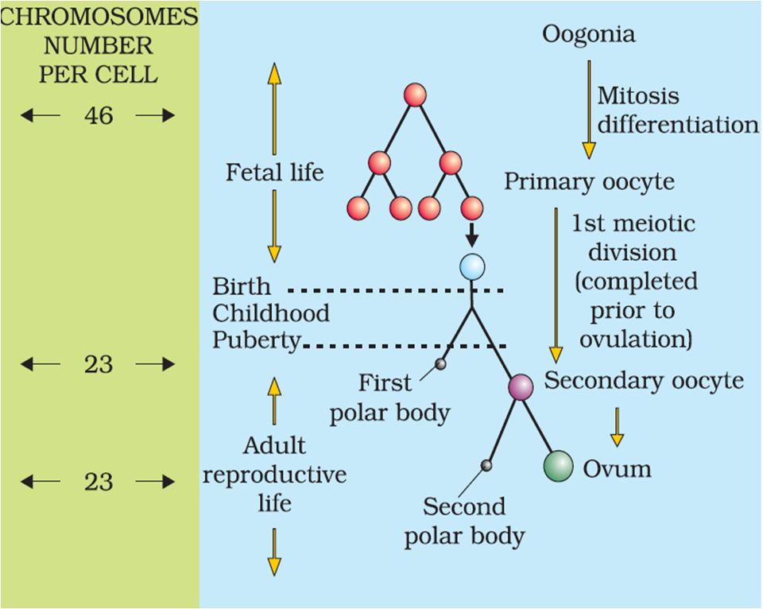
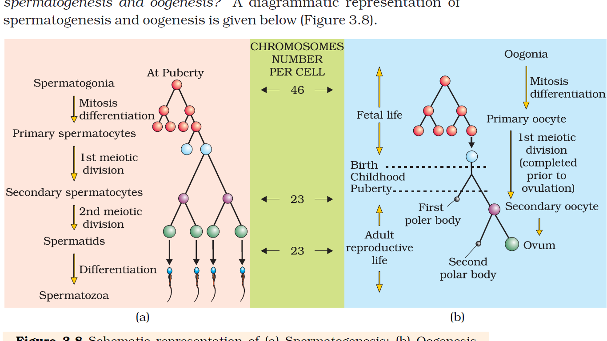
GAMETOGENESIS
Spermatogenesis
Oogenesis
Spermiation is a process of release of spermatozoa (sperms) from seminiferous tubules.
Spermiogenesis

Slide 61
Spermatogenesis
The human male ejaculates about 200 to 300 million sperms during a coitus
For normal fertility, at least 60% sperms must have normal shape and size and for at least 40% sperm must show vigorous motility.
Sperms released from the seminiferous tubules, are transported by the accessory ducts.
Secretions of epididymis, vas deferens, seminal vesicle and prostate are essential for maturation and motility of sperms.
Semen = Seminal plasma + Sperm
The functions of male sex accessory ducts and glands are maintained by the testicular hormones (androgens).
Spermatogenesis starts at puberty
During puperty there is significant increase in the secretion of gonadotropin releasing hormone (GnRH) -a hypothalamic hormone.
The increased levels of GnRH then acts at the anterior pituitary gland and stimulates secretion of two gonadotropins – luteinising hormone (LH) and follicle stimulating hormone (FSH).
LH acts at the Leydig cells and stimulates synthesis and secretion of androgens.
Androgens, in turn, stimulate the process of spermatogenesis.
FSH acts on the Sertoli cells and stimulates secretion of some factors which help in the process of spermiogenesis.

Slide 62
Oogenesis (The process of formation of a mature female gamete)
Millions of oogonia (gamete mother cells) are formed within each fetal ovary during the embryonic development; no more oogonia are formed and added after birth.
⇣^{Meiotic division}
Meiosis of Oogonia get temporarily arrested at prophase-I and are called primary oocytes
Each primary oocytes gets surrounded by primary follicle (a layer of granulosa cells).
⇣ ^{Degeneration} ^{of large number of} primary follicles (from birth to puberty); 60,000-80,000 primary follicles are left in each ovary during puberty
Primary follicles get surrounded by secondary follicles (more layers of granulosa cells)
The secondary follicles transforms into a tertiary follicles which are surrounded by an theca interna and a theca externa (and have an antrum -fluid filled cavity).
The primary oocyte within the tertiary follicle grows in size
After meiosis I of primary oocyte, a large haploid secondary oocyte and a tiny first polar body are formed
Entry of sperm into the cytoplasm of the ovum (through the zona pellucida and the plasma membrane) induces the completion of the metaphase II of the secondary oocyte.
The second meiosis results in the formation of a second polar body and a haploid ovum (ootid).
Later, haploid ootid will develop into ovum
The tertiary follicle further changes into the mature follicle or Graafian follicle.
The secondary oocyte forms a new membrane called zona pellucida surrounding it.
The Graafian follicle ruptures to release the secondary oocyte (ovum) from the ovary by the process called ovulation.
Notes:
Oogenesis is initiated during the embryonic development stage
Millions of gamete mother cells (oogonia) are formed within each fetal ovary; no more oogonia are formed and added after birth.
Oogonia start meiotic division and get temporarily arrested at prophase-I of the meiotic division and are called primary oocytes.
Each primary oocyte then gets surrounded by a layer of granulosa cells and then called the primary follicle.
A large number of these follicles degenerate during the phase from birth to puberty.
At puberty only 60,000-80,000 primary follicles are left in each ovary.
The primary follicles get surrounded by more layers of granulosa cells and a new theca and called secondary follicles.
The secondary follicle soon transforms into a tertiary follicle which is characterised by a fluid filled cavity called antrum.
The theca layer (tertiary follicle) is organised into
an inner theca interna and
an outer theca externa.
The primary oocyte within the tertiary follicle grows in size and completes its first meiotic division resulting in the formation of a large haploid secondary oocyte and a tiny first polar body.
Entry of sperm into the cytoplasm of the ovum through the zona pellucida and the plasma membrane induces the completion of the metaphase II of the secondary oocyte.
The second meiotic division results in the formation of a second polar body and a haploid ovum (ootid).
Later, haploid ootid will develop into ovum
The tertiary follicle further changes into the mature follicle or Graafian follicle.
The secondary oocyte forms a new membrane called zona pellucida surrounding it.
The Graafian follicle ruptures to release the secondary oocyte (ovum) from the ovary by the process called ovulation.
The tertiary follicle further changes into the mature follicle or Graafian follicle.
The secondary oocyte forms a new membrane called zona pellucida surrounding it.
The Graafian follicle ruptures to release the secondary oocyte (ovum) from the ovary by the process called ovulation.

